Slide 1
Progress Review 01
Direct Expansion Solar Assisted Heat Pump (DX-SAHP)
Charuka Marasinghe
Dhruvi Patel
Edwin Pulikkottil
Jessica Sambi
Kerwin Virtusio
Nadia El Gamal
October 22, 2021
Notes:
Our capstone project is the design of a direct expansion solar assisted heat pump system.
I am……..This is……………….

Slide 2




Project Background
Renewable energy is needed to combat climate change
Water heating is a primary source of greenhouse gas emissions
Average Canadian uses 75L of hot water per day
Water heating accounts for 19.3% of residential energy
Notes:
Climate change is arguably one of the most critical global issues the world is currently facing
Hot water heating is a primary source of greenhouse gases in residential and commercial sectors
This heat pump will reduce the usage of natural gas heating for hot water, which accounts for 19.3% of the energy used in the average Canadian home

Slide 3




Design Motivation
Constant heating is required in cold climates
Calgary has the most hours of sunshine in Canada
A SAHP can provide up to 90% of the hot water in an average home
Allow the consumer to save on energy/heating costs
Notes:
Solar assisted heating is already being used in warmer climates
We are adapting the system to be used in cold climates
It will be most applicable to Calgary since we receive the most amount of sunlight in Canada
This is important because, as you may have noticed, even if the temperature outside is below 0, it can get up to the 20’s indoors with natural heating from sunlight
The collector is able to utilize ambient temperatures in addition to solar irradiation to evaporate the refrigerant
If we are able to utilize solar irradiation in calgary, we can greatly reduce natural gas needs
A solar assisted heat pump can provide up to 90% of the hot water in an average home

Slide 4
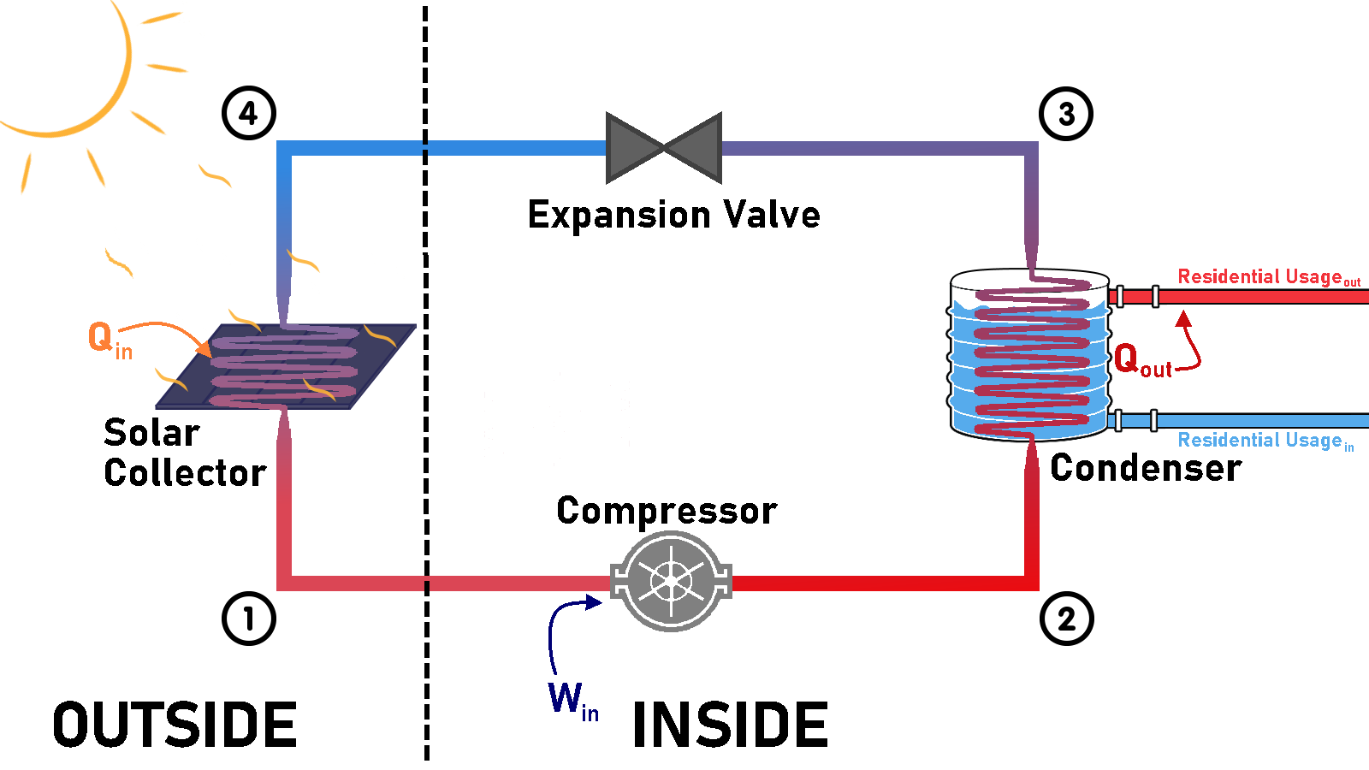
DX-SAHP Schematic

Slide 5
Goals & Major Deliverables
Design a Solar Thermal Collector
Match System Components
Assemble and Test Working Model
Validate Quantifiable Goals
225L of domestic hot water per day
Coefficient of Performance (COP)
Environmental Impacts
Complete with necessary control and data acquisition systems
Test in proposed design locale (Calgary)
Notes:
Design a thermal solar collector capable of satisfying the heat load requirements of an average canadian household. This is roughly 225 Litres of hot water per day.
Perform a component matching analysis to design an integrated Solar Thermal Hot-water System, complete with all necessary control and data acquisition systems.
Assemble and test a working model to consolidate the system’s subcomponents and test them in the proposed design locale(Calgary).
Validate quantifiable and measurable goals:
Do we achieve our design goals (225 L) with a reasonable COP?
Do the Return on Investment and societal shift to renewables justify the proposed system?

Slide 6





Member Roles
Project
Manager
Collector Design/Sizing
Component Matching
Assembly
Lead
Control
System Design
Testing
Lead
Kerwin
Virtusio
Nadia
El Gamal
Jessica
Sambi
Charuka
Marasinghe
Dhruvi
Patel
Edwin
Pulikkottil

Slide 7
Milestones
Nov. 15, 2021
1st iteration of collector design
Dec. 1, 2021
Final design with all compatible components
Dec. 10, 2021
Complete Bill Of Materials (BOM)
Mar. 1, 2022
Begin testing
(prototype completed)
Notes:
We aim to have the first iteration of the collector design along with top 3 of each component chosen by November 15, 2021 so that we can have our final design completed with all of the final components selected by December 1, 2021. From here, we aim to order all of our parts by December 10 so that gives us at least a 2 month lead time and also time to get our prototype ready. We hope to begin testing of our prototype by March 1, 2022.

Slide 8
Progress
Current Stage
Next Steps
Refrigerant selection and preliminary calculations
Parametric studies on collector subcomponent
Schematic and roadmap
Transient analysis to determine evaporation temperatures
Contact vendors on feasibility and lead times
Notes:
To END IT OFF (Jessica): Together, we hope to fully design our system and develop our prototype of the solar collector while recognizing that this technology results in energy savings and contributes to the reduction of emissions of greenhouse gases into the atmosphere!

Slide 9
Questions?

